Slide 1
Network Scanning with Nmap

Slide 2
Introduction
The first step is Information Gathering
Discover the services which are open or closed
Version label
Operation System and its types

Slide 3
1.byte streaming
Segment is collection of bytes
2.Connection Oriented
3.Full Duplex
4.Piggybacking
Receiver can send the ack number with data also
5.Error control
6.Flow Control
7.congestion control

Slide 4
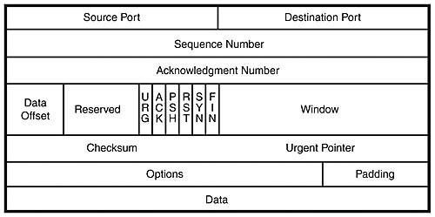
Pre Study
TCP Packet Header
SIZE OF HEADER
20-60 BYTE
SOURCE PORT 16
0-65535
0-1023 WELL KNOWN PORTS
RANDOM 60001
DESTINATION 80
TCP
CONVERT BITS INTO BYTES
SEGMENT
1 1003 1 1002 1 1001
ACK NUM
1 1006 1 1005 1 1004

Slide 5
Cont..
Source and Destination Ports
Sequence Number and Acknowledgment Number
Data Offset ,Reserve , Control flag, Window
Checksum, Urgent Pointer
Options, Padding
Data

Slide 6
TCP Flag Definitions
Flag
SYN | The beginning of a connection
ACK | Acknowledge receipt of a previous packet or transmission
FIN | Close a TCP connection
RST | Abort a TCP connection

Slide 7
TCP conversation
Connect
Disconnect
Client
Server
Client
Server
SYN
FIN
SYN/ACK
ACK/FIN
ACK
ACK
Connection Established
Connection
Closed
Three-way handshake

Slide 8
What is nmap?
NMAP is a free and open source utility for network discovery and security auditing. Like there are too many devices connected to the network and a pentester or network administrators will gather a information like which type of devices, their services uptimes, live systems, which kind of services are running their with the help of this utility.
ZENMAP :-GUI

Slide 9
Quick Start Cheat-sheet
Switch Description Example
-sS TCP SYN port scan. nmap -sS 192.168.1.1
-sT TCP Connect port scan nmap -sT 192.168.1.1
-sU UDP port scan. nmap -sU 192.168.1.1
-sA TCP ACK port scan. nmap -sA 192.168.1.1

Slide 10
Conti......
Switch Description Example
-Pn Only port scan. nmap -Pn 192.168.1.1
-sn Only host discovery. nmap -sn 192.168.1.1
-PR ARP discovery nmap -PR 192.168.1.1
-n Disable DNS resolution. nmap -n 192.168.1.1

Slide 11
HOST Scan
This Scan is used to find or identify active host in the network by sending ARP request packets to all system in that network. And in result it will show a message “Host is up” by Receiving MAC address from Each active host.
Syntax: - nmap -sP target_ip_range
nmap -sn target_ip_range

Slide 12
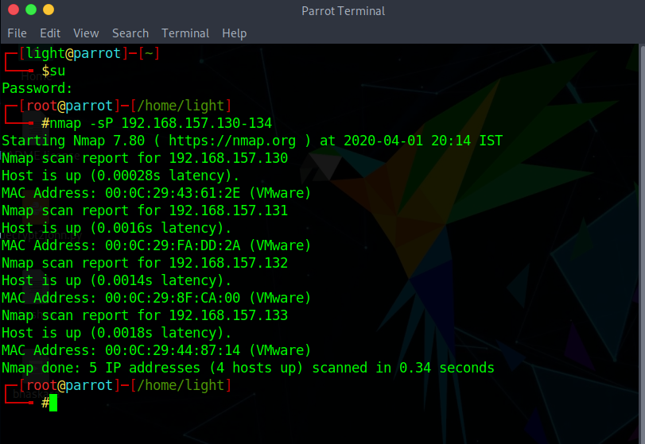

Slide 13
Port Scan/TCP Scan/Stealth Scan
With the help of this scan, User can Identify open or close state of a particular port on target machine.
Six Types of Port status
Open
Closed
Filtered
Unfiltered
Open/Filtered
Closed/Filtered

Slide 14
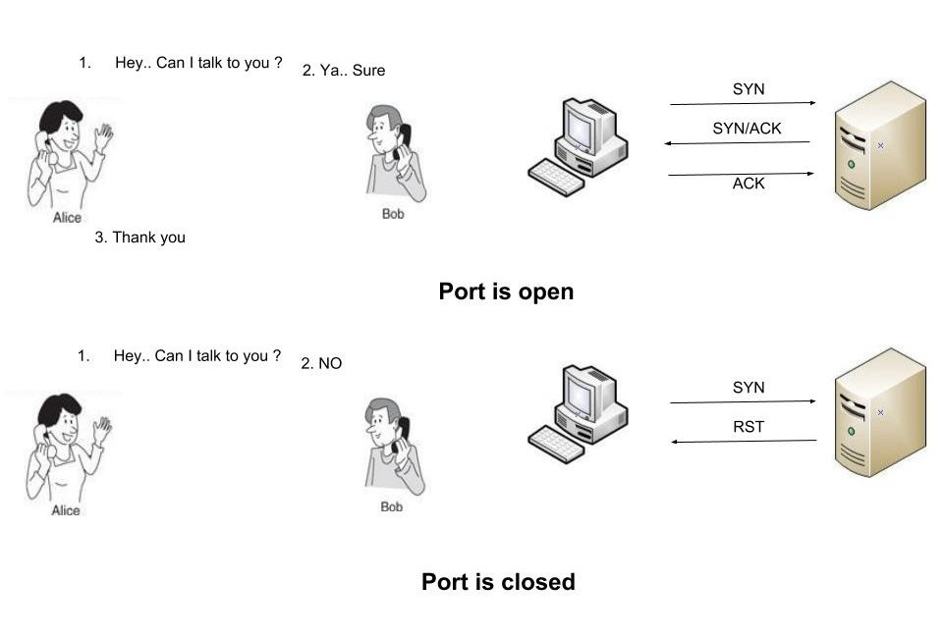
Syntax :-
nmap -p port_number or service_name target_IP_range
nmap -sT port_number target_IP_range

Slide 15
UDP Scan
This method is used to list all open UDP ports on a host.With the help of this scan penetration testers know that they often expose host essential information or can even be vulnerable moreover used to compromise a host.
Syntax:- nmap -sU target_IP

Slide 16
XMAS SCAN
This scan is accomplished by sending packets with the FIN, URG and PUSH flags, if the server sends RST’s regardless of the port state, then that is not vulnerable to this type of scan. If the client didn’t get any response, then the port is considered as open.
Xmas Scan is only workable in Linux machines and does not work on the latest version of windows

Slide 17
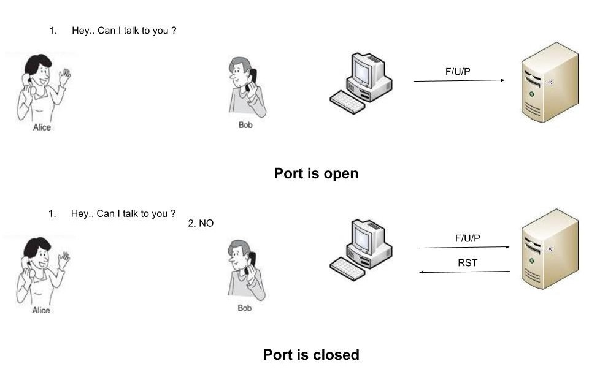
Syntax :- nmap -sX target_IP

Slide 18
NULL Scan
Null scan sends a packet with no flags switched on, if the server sends RST’S regardless of the port state, them that is not vulnerable to this type of scan. If the client didn’t get any response, them the port is considered as open.
Syntax :- nmap -nS target_IP

Slide 19
FIN Scan
A FIN packet is used to terminate the tcp connection between source and destination port typically after the data transfer is complete. In the place of SYN packet, Nmap starts a FIN scan by using a FIN packet. If the port is open then no response will come from destination port when FIN packet is send through source port.
Syntax: - nmap -sF target_IP

Slide 20
OS Detection Scan
Apart from open port enumeration nmap is quite useful in OS fingerprinting. This scan very helpful to penetration tester in order to conclude possible security vulnerabilities and determining the available system calls to set the specific exploit payloads.
Device type
Running
OS CPE
OS details

Slide 21
Cont..
Syntax: nmap -O target_ip
Syntax: nmap -O -p- –osscan-guess <target>
Syntax: nmap -O –osscan-limit <target>

Slide 22


